Slide 1
FUTURE SALE
PREDICTION

Slide 2




















M.KALAIMUTHAMIZHAN
B.DEENADHAYALAN
M.SANTHOSH
S.ARUN KUMAR
P.BASKAR
TEAM MEMBERS

Slide 3

1.INTRODUCTION TO SALE FORECASTING TECHNIQUES
In the rapidly evolving world of sales, accurate prediction is vital to success. Forecasting the future of sales requires advanced techniques that go beyond traditional methods.
This article explores cutting-edge approaches that leverage data analysis, machine learning, and predictive modeling to provide businesses with actionable insights for more reliable sale predictions. Let's dive into the world of advanced sale prediction techniques!

Slide 4

2.TRADITIONAL METHODS VS ADVANCED TECHNIQUES
Traditional methods of sales forecasting, such as historical data analysis and market research, have limitations in today's rapidly changing business environment. Advanced techniques, such as arti cial intelligence and predictive analytics, o er more accurate and actionable insights. By leveraging these advanced techniques, businesses can gain a competitive edge and make informed decisions to drive sales growth.

Slide 5

3.UNDERSTANDING THE IMPORTANCE OF ACCURATE PREDICTIONS
Accurate sales predictions are crucial for businesses to make informed decisions and drive sales growth. By incorporating advanced techniques like arti cial intelligence and predictive analytics, businesses can gain a better understanding of market trends, customer behavior, and sales patterns. These insights enable them to anticipate demand, optimize inventory levels, and align resources e ectively, ensuring they stay ahead in the ever-evolving business landscape.

Slide 6

4.MACHINE LEARNING ALGORITHMS FOR SALES PREDICTION
Machine learning algorithms are a powerful tool for sales prediction. By analyzing historical sales data and identifying patterns and trends, these algorithms can generate accurate predictions for future sales. By leveraging machine learning, businesses can make data-driven decisions, optimize their sales strategies, and stay one step ahead of the competition in an increasingly competitive marketplace.

Slide 7

5.TIME SERIES ANALYSIS AND FORECASTING
Time series analysis is a crucial technique for sales prediction. By analyzing past sales data and identifying key patterns, trends, and seasonality, businesses can forecast future sales with accuracy. This allows them to optimize inventory planning, marketing strategies, and resource allocation, ultimately staying ahead of the competition and maximizing sales revenue.

Slide 8

6. DATA MINING AND SALES ANALYTICS
Data mining and sales analytics play a crucial role in predicting future sales. By analyzing large datasets, businesses can uncover valuable insights and patterns that can be used to make accurate sales forecasts. These techniques help businesses identify customer preferences, optimize pricing strategies, and forecast demand, enabling them to make informed decisions and drive sales growth.

Slide 9

7. INCORPORATING EXTERNAL FACTORS IN SALES FORECASTING
Incorporating External Factors in Sales Forecasting
To improve sales forecasting accuracy, it's important to consider the impact of external factors. Factors like economic trends, competitor activities, and changes in customer behavior can signi cantly in uence sales. By incorporating these variables into forecasting models, businesses can make more accurate predictions and adapt their sales strategies accordingly, ultimately maximizing revenue and pro tability.

Slide 10

8.ENHANCING ACCURACY WITH ARTIFICIAL INTELLIGENCE
Arti cial Intelligence (AI) has revolutionized sales forecasting by analyzing vast amounts of data and identifying complex patterns that human analysts may overlook. AI-powered forecasting models can provide more accurate predictions by incorporating not only historical sales data but also external factors like social media trends, weather patterns, and market insights. This advanced technique enables businesses to make proactive decisions, optimize resources, and stay ahead of the competition in an increasingly dynamic market environment.

Slide 11

9.CASE STUDIES ON SUCESSFUL SALES PREDICTION
In recent case studies, companies that integrated advanced sales prediction techniques using AI achieved signi cant improvements in their forecasting accuracy. By leveraging AI's ability to analyze diverse data sources and identify hidden patterns, these companies gained a competitive advantage and were able to make informed decisions, optimize inventory management, and enhance customer satisfaction.

Slide 12
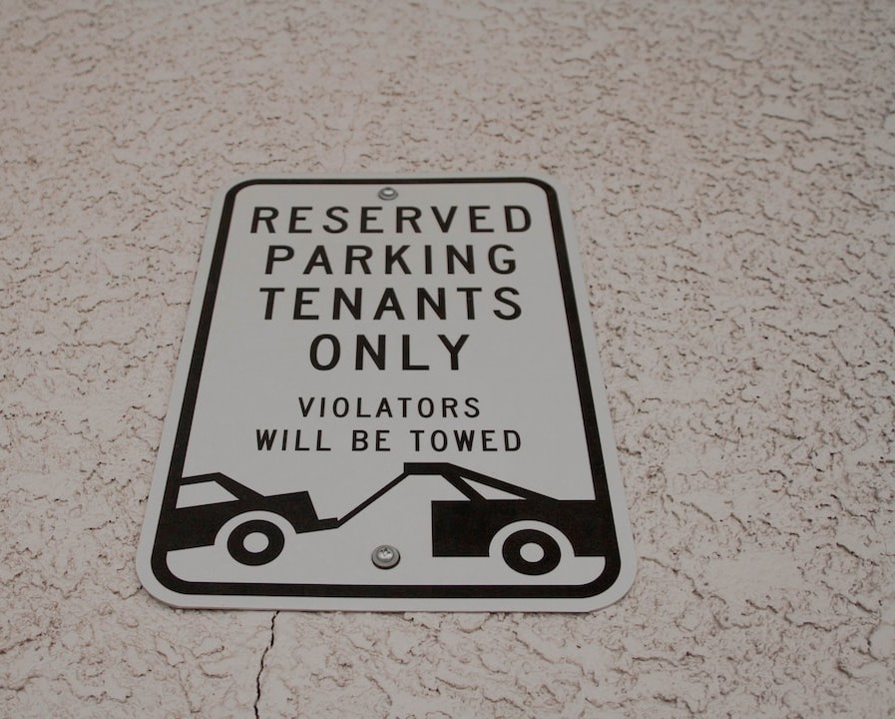
10.BEST PRACTICES FOR IMPLEMENTING ADVANCED TECHNIQUES
When implementing advanced sales prediction techniques, there are several best practices to keep in mind. First, ensure that you have high-quality and diverse data sources for accurate analysis. Second, choose the right AI algorithms and models that align with your speci c business needs. Third, regularly review and update your models as new data becomes available. Lastly, collaborate with all relevant stakeholders to ensure successful implementation and utilization of these techniques.

